Slide 1
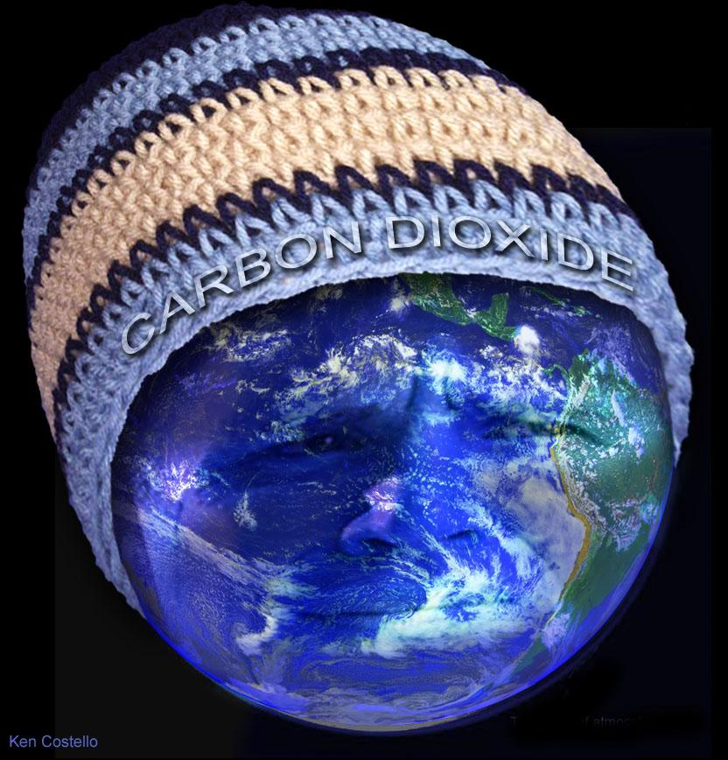
Global Warming (Accelerated Climate Change)
Notes:
Show videos from NOAA. 3 short ones on Sea Ice. One larger one called “On Sea Ice” from Universe Odyssey.

Slide 2
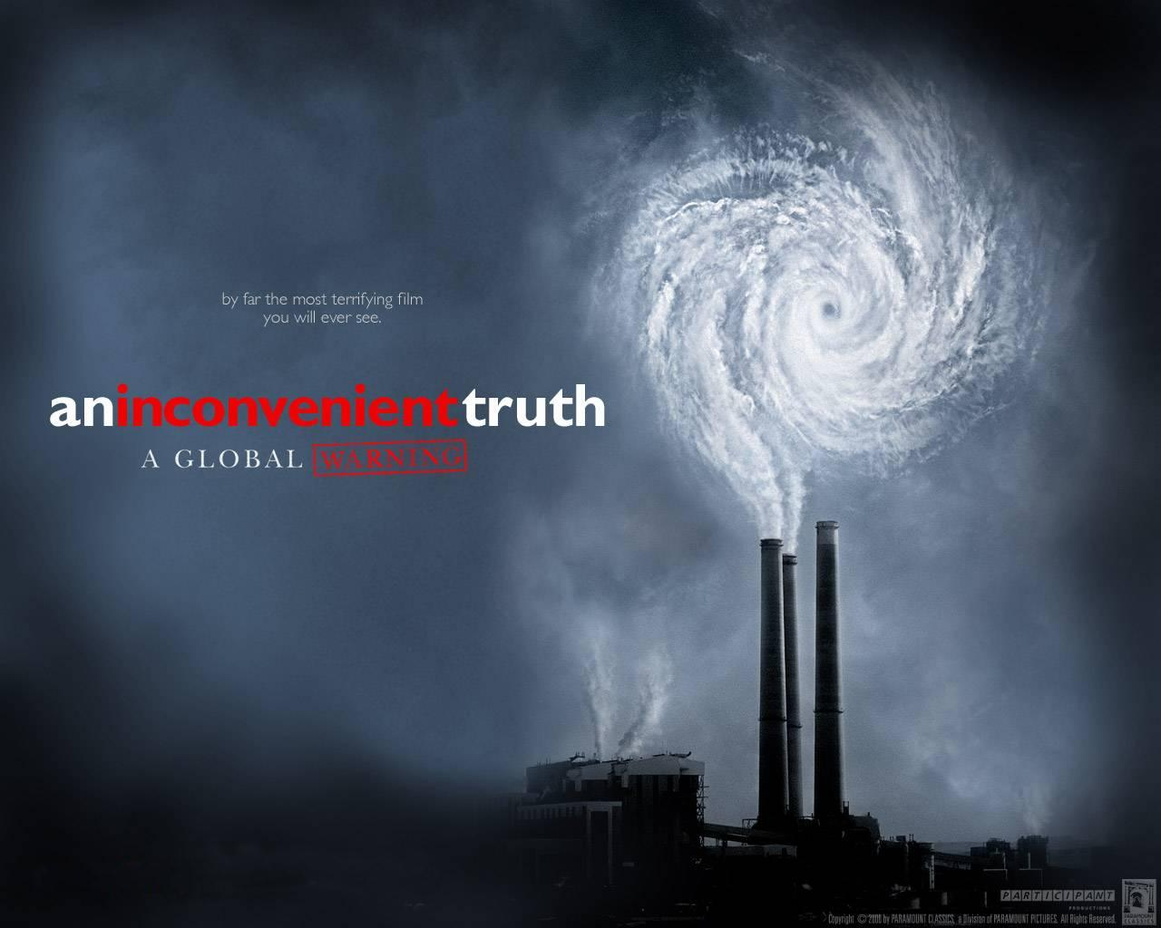

Slide 3
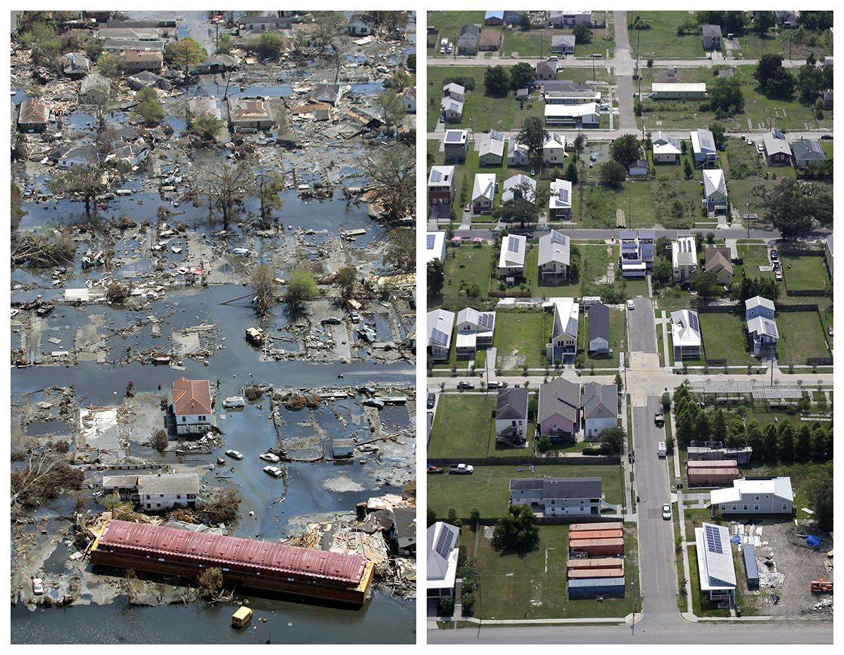

Slide 4
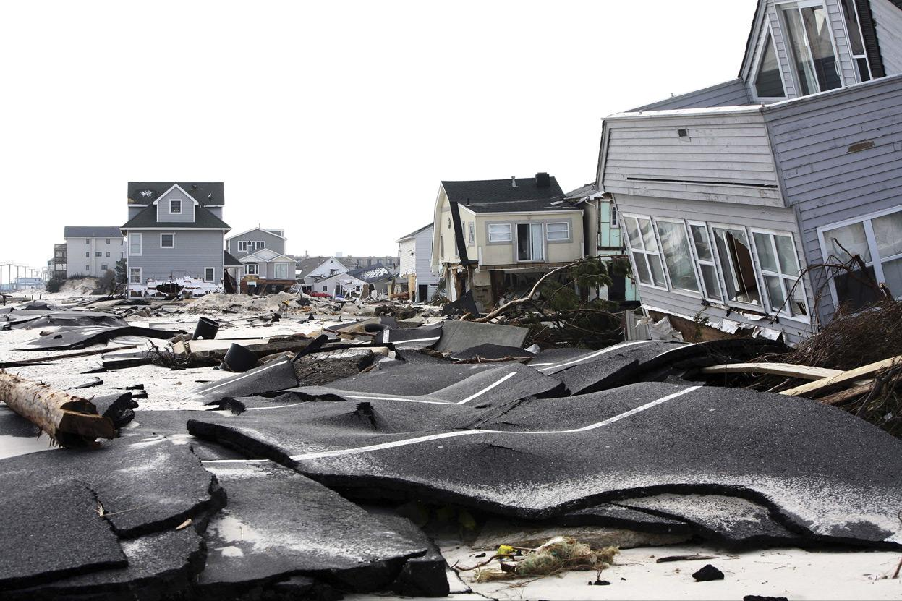

Slide 5
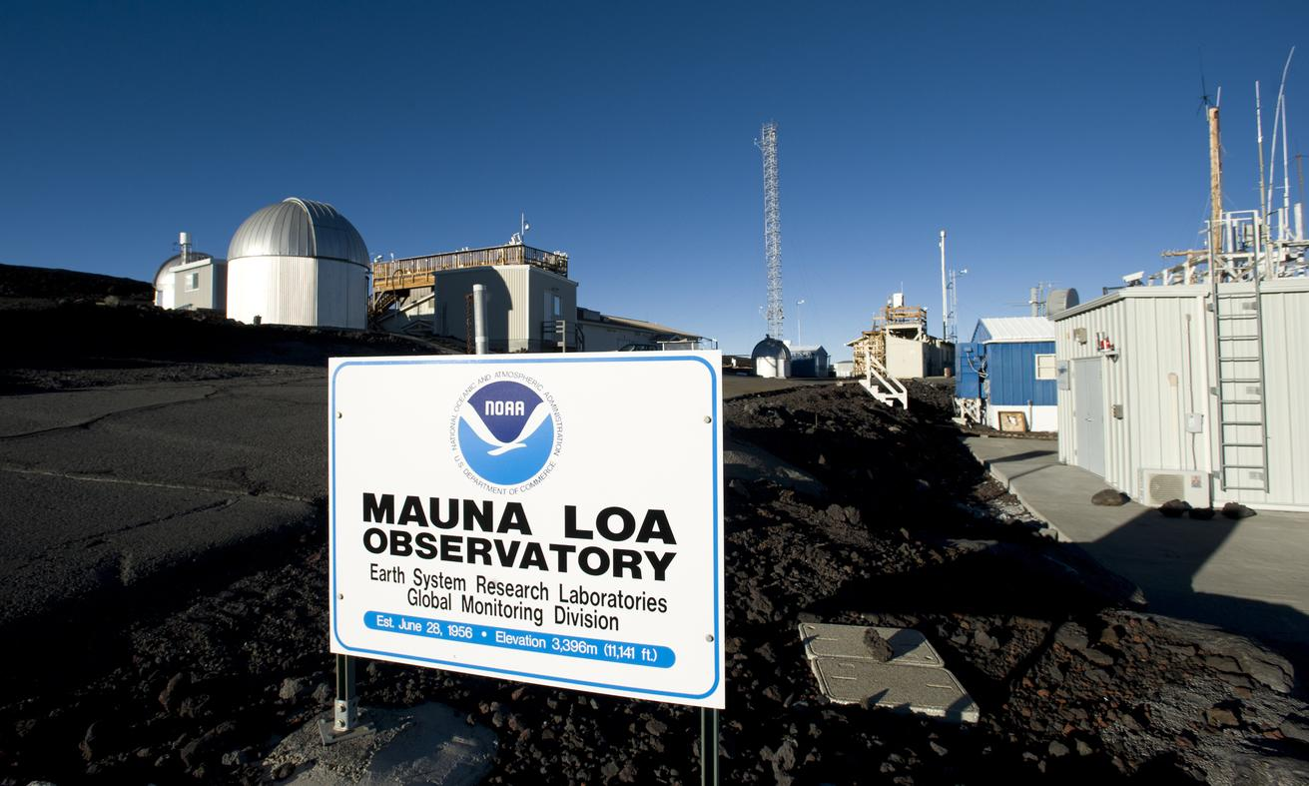

Slide 6
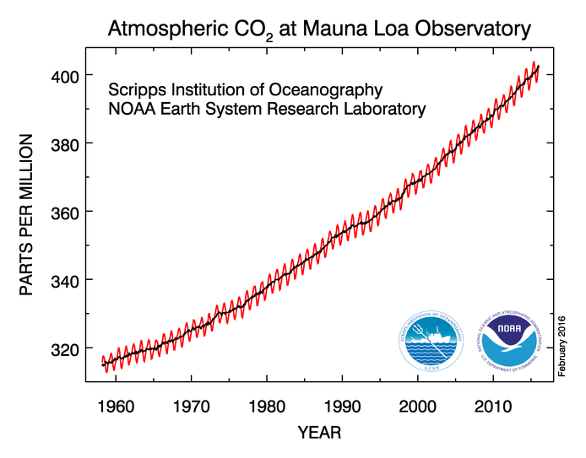

Slide 7
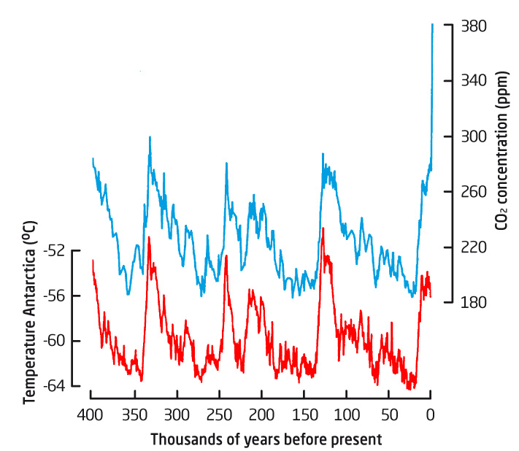
Ratio of water with hydrogen versus water with deuterium.

Slide 8
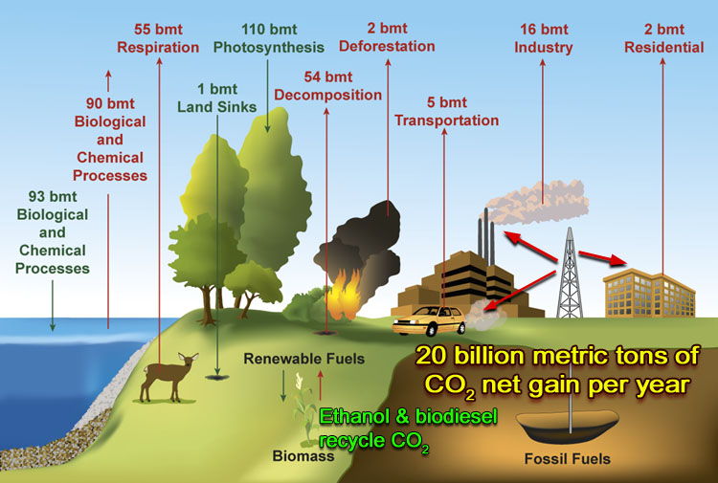
Where does the extra CO₂ come from?

Slide 9
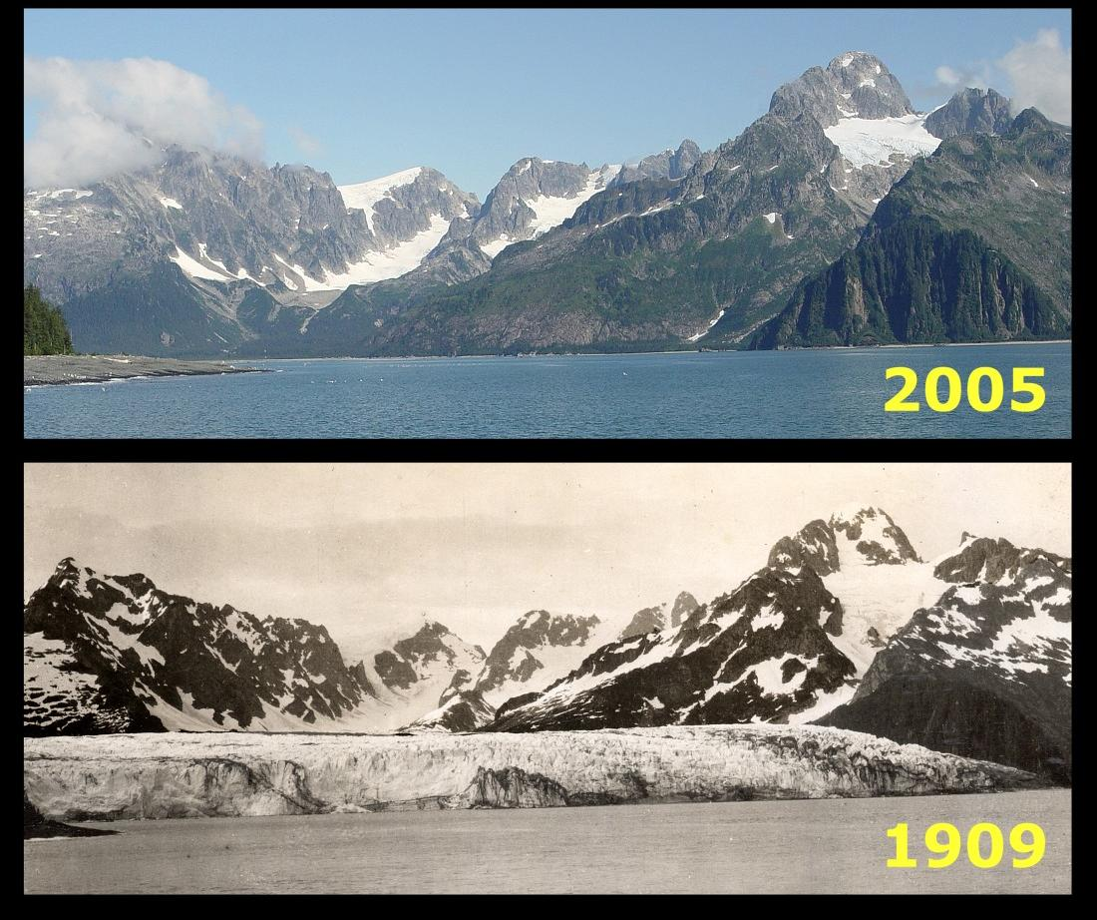
Glacier National Park

Slide 10
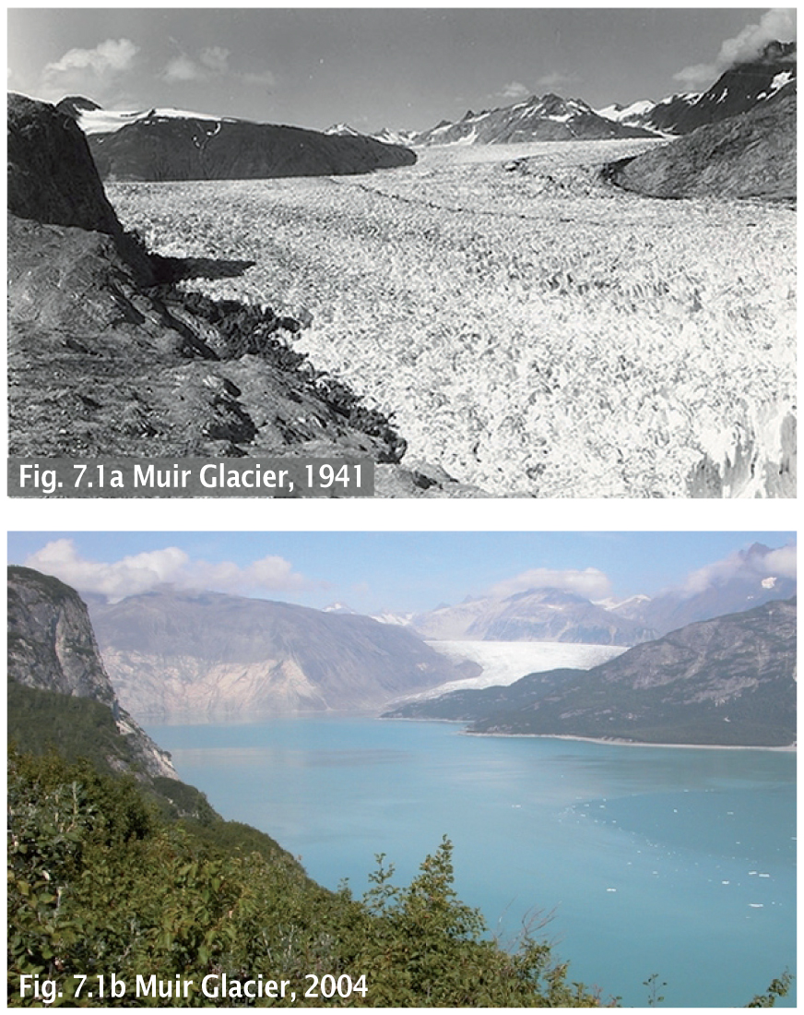

Slide 11
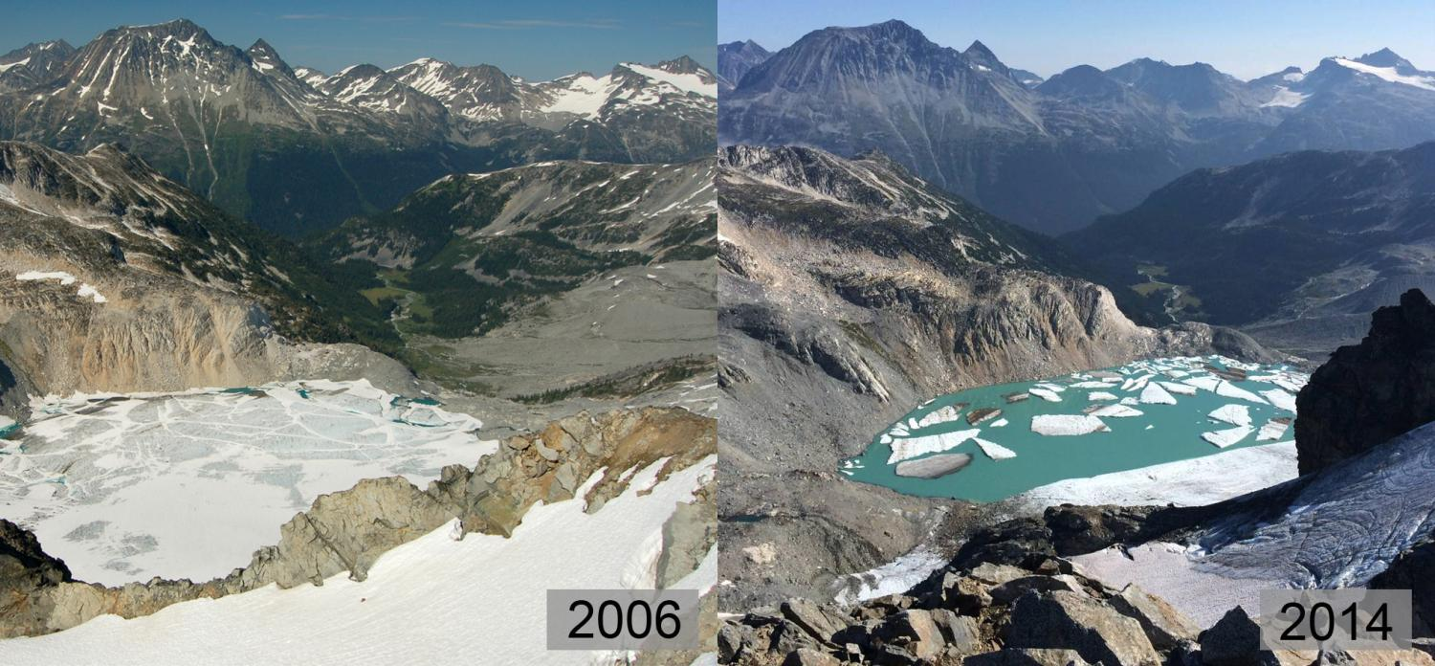
The Decker Glacier near Whistler, Canada

Slide 12
Record Heat
2015 is hottest year on record
https://youtu.be/bzV_JmTvReA
January 2016 is hottest month on record
February has set many heat records here in Phoenix.
This last February is now the hottest February on record for Phoenix and the whole world.

Slide 13
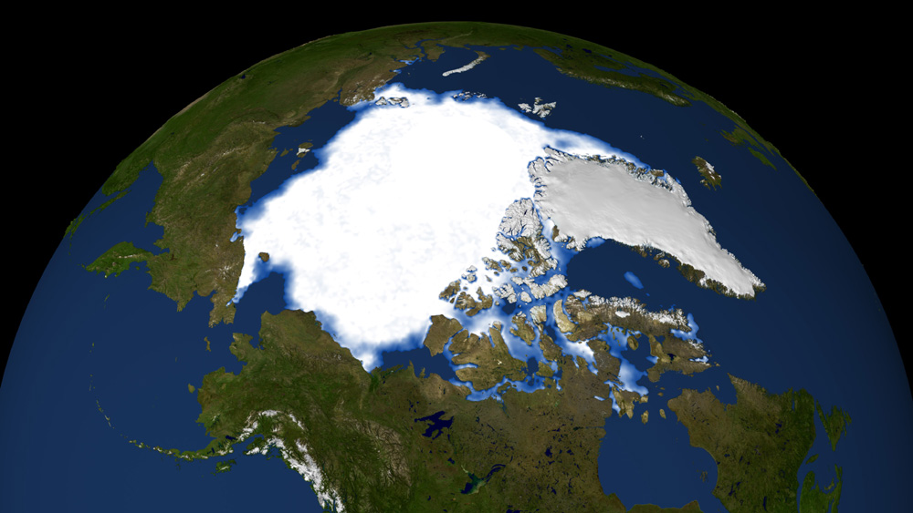
Sea ice coverage during the summer of 1983

Slide 14
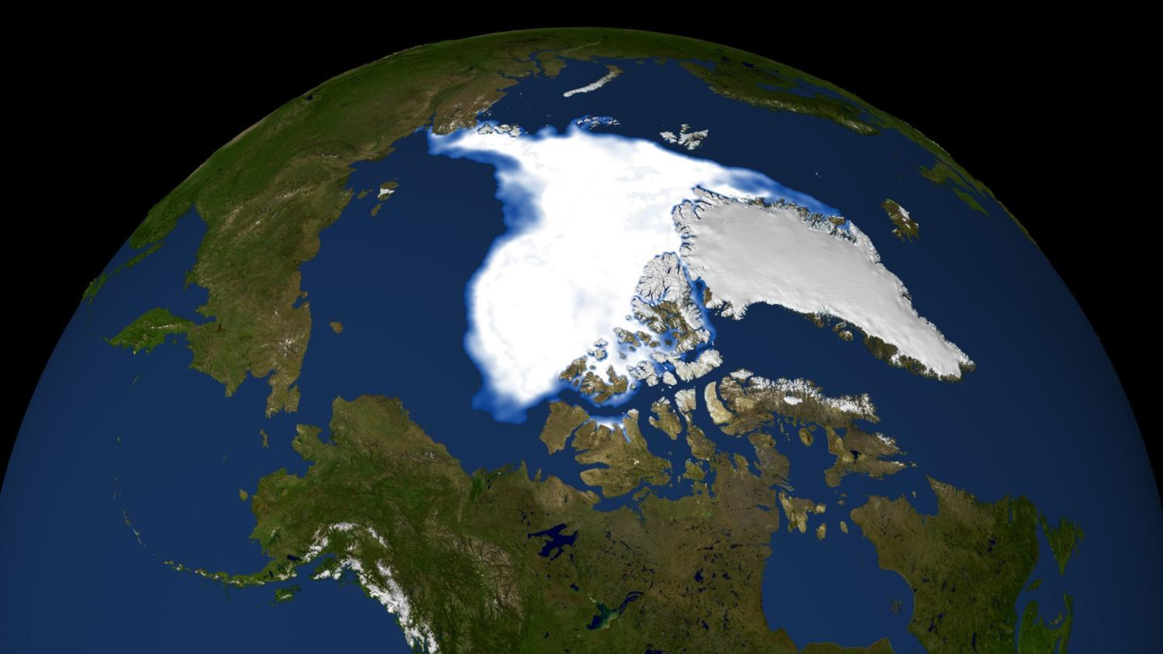
Sea ice coverage during the summer of 2007

Slide 15
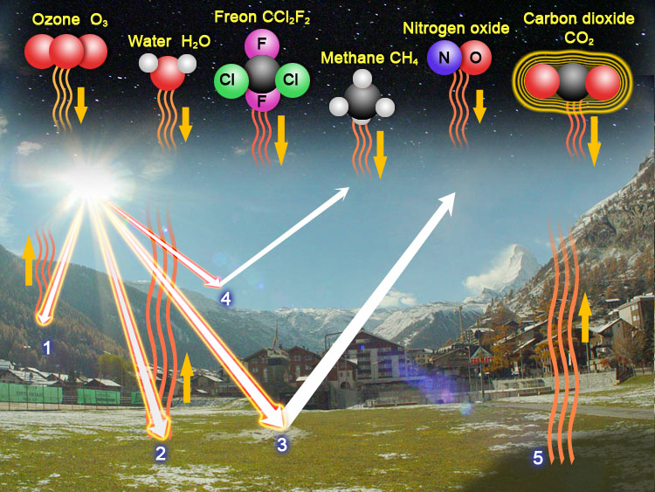
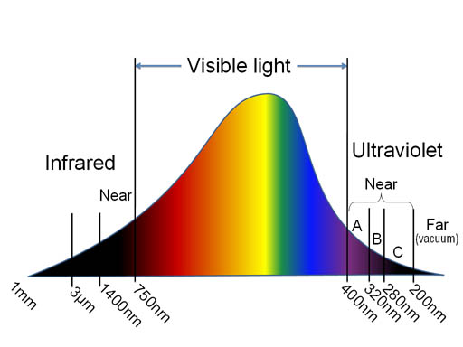

Slide 16
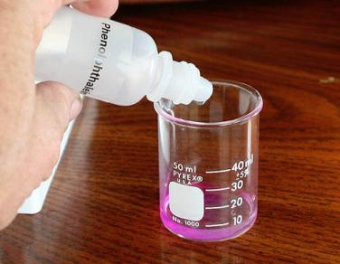
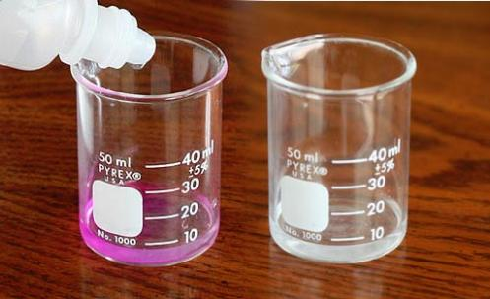
H
H
O
C
O
O
Ca
O
11
+
+
2+
H
H
O
Ca(OH)_{2(s)} → Ca²⁺_{(aq)} + 2OH⁻_{(aq)}
CO_{2(g)} + H₂O_{(l)} → H₂CO_{3(aq)}
H⁺ + OH⁻ → H₂O

Slide 17
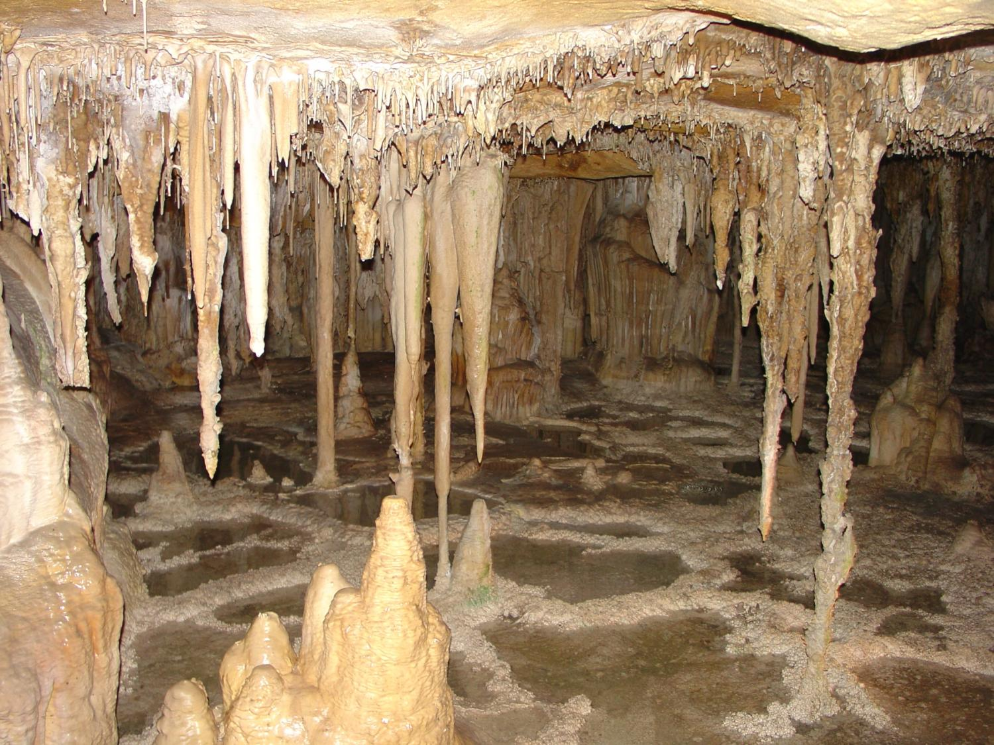
Carbonic acid dissolves calcium carbonate to form caves.

Slide 18
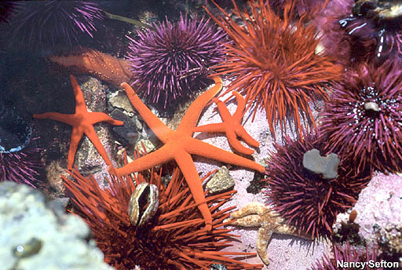
Carbonic acid from carbon dioxide dissolves or inhibits calcium carbonate shells of marine life.

Slide 19
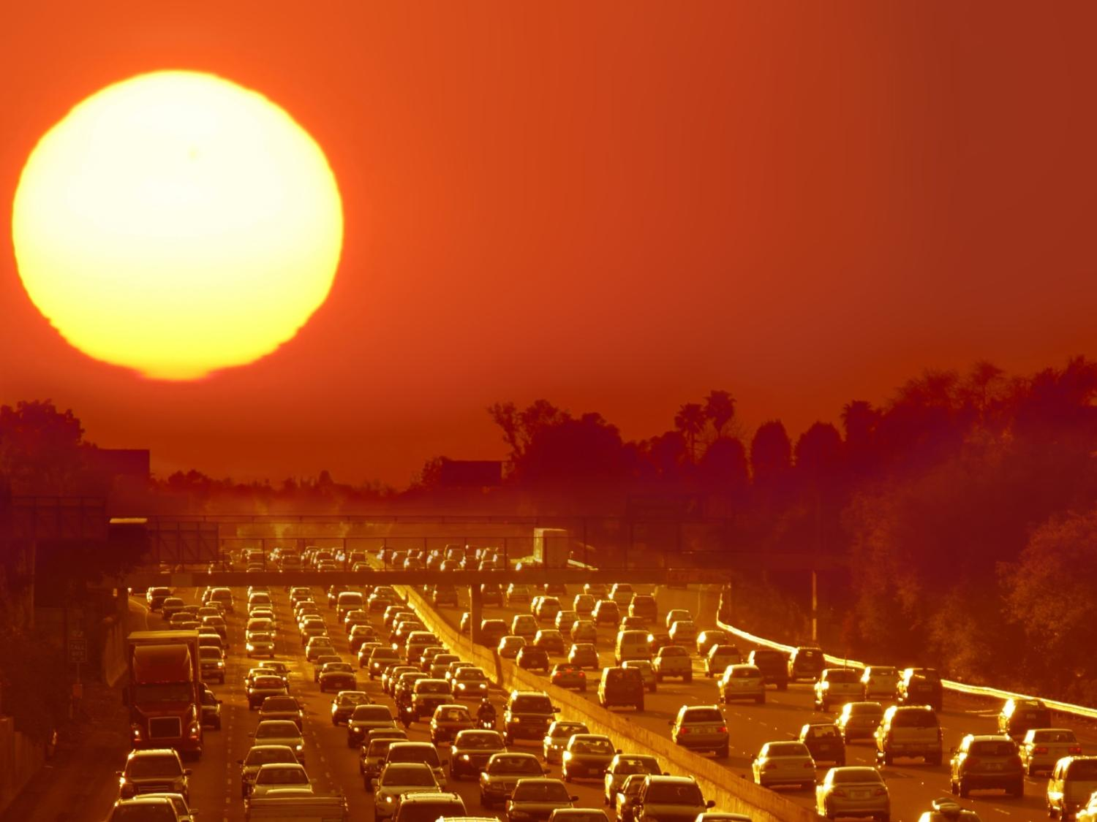
No Stopping Global Warming.
Begin Coping with the Heat.

Slide 20
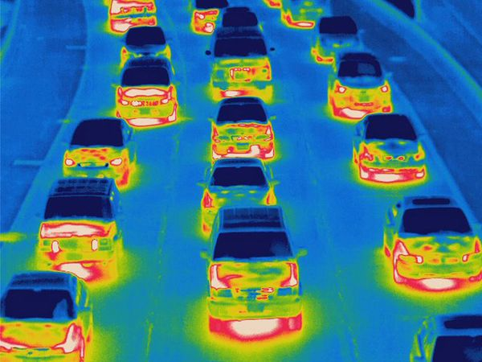
We will have to pay attention not only to the heat trapped by CO2, but also by heat emitted by our cars and appliances.

Slide 21
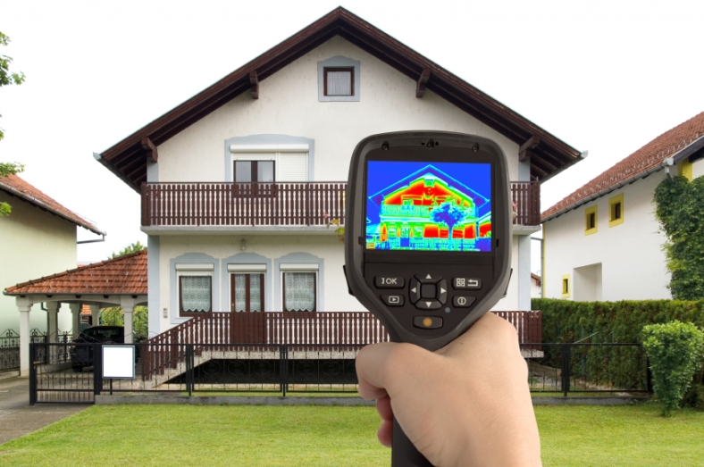
We have to learn how to see heat using thermal imaging (FLIR=forward looking infrared)

Slide 22
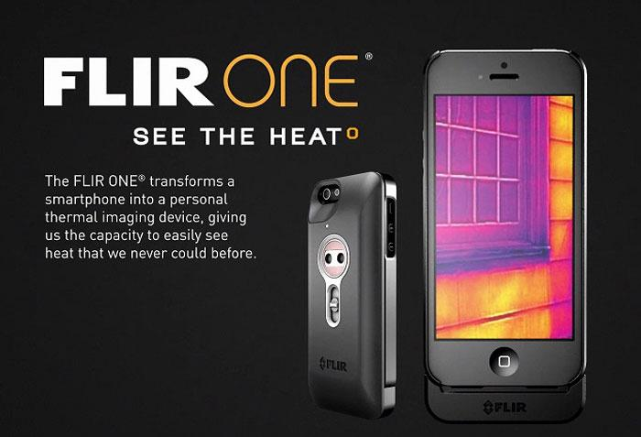
Attachments for Smartphones One phone has Infrared built-in

Slide 23
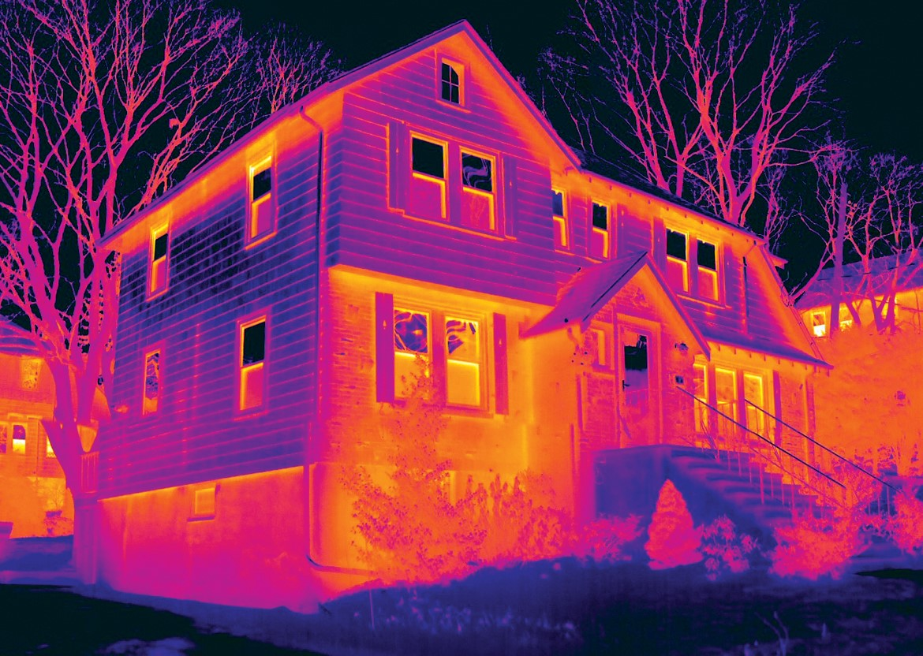

Slide 24
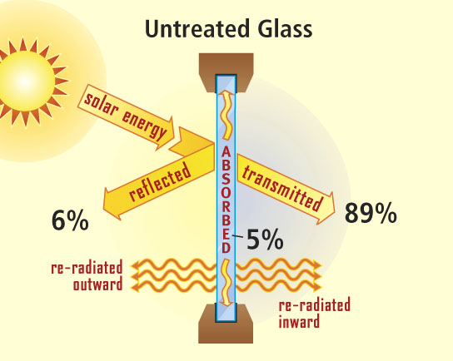
Most of the solar energy passes through windows.

Slide 25
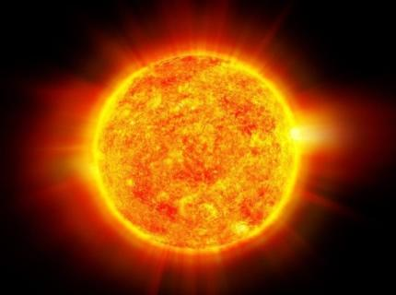
Knowledge of Window film
← Infrared ←
Infrared → →
Visible light → →
Ultraviolet → →
← Ultraviolet ←

Slide 26
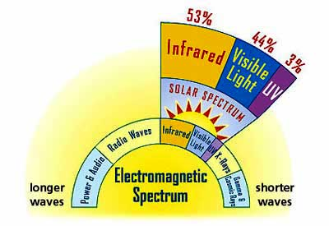
Knowledge of the solar energy spectrum.

Slide 27
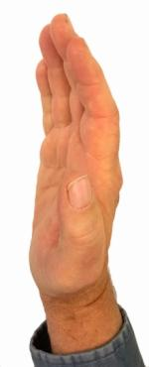
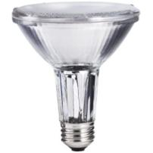
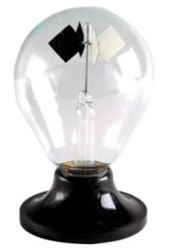
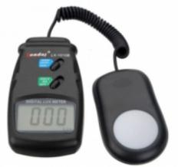
Measuring Window film and other solar blocking materials
Glass with solar blocking material
Your Hand
Incandescent
Light Source
Infrared thermometer
Radiometer
Light Meter

Slide 28
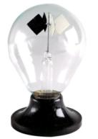
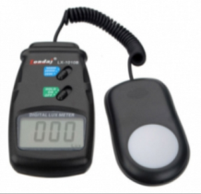
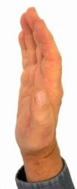
Glass alone | Solar film | Aluminum | Dry Paper | Wet Paper
Radiometer
List its spinning rate as Fast, Medium, Slow, or Stopped. This mostly measures infrared light.
Light Meter
List the visible light level in Lux.
For the hand, report the sense of heat as hot, medium, or cool.
Your Hand
Report temperature of a black object behind the glass in Fahrenheit and Celsius.
Infrared thermometer
Optional fifth tool

